Slide 1

Demystifying Neural Networks
Brandon Wen
October 15, 2019

Slide 2

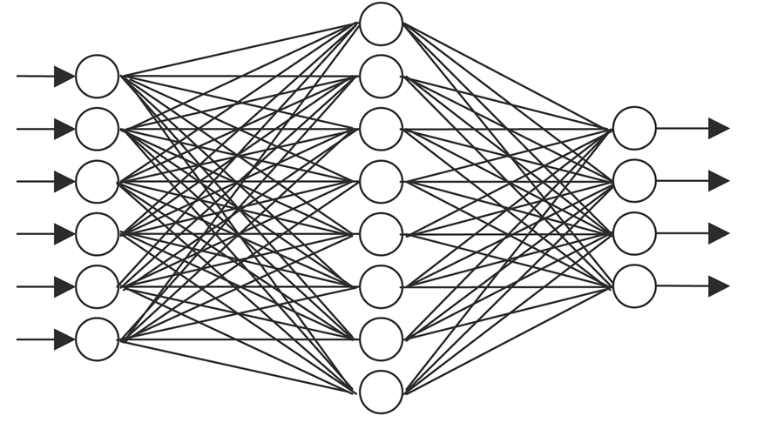
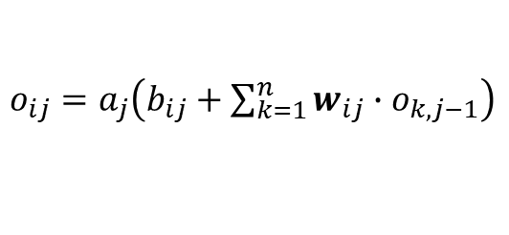
A complete black box to most
It’s a cat!
Input
$o_{ij}=a_{j}\left(b_{ij}+\sum_{k=1}^{n}{w_{ij}{∙o}_{k,j−1}}\right)$
Output
MNIST

Slide 3
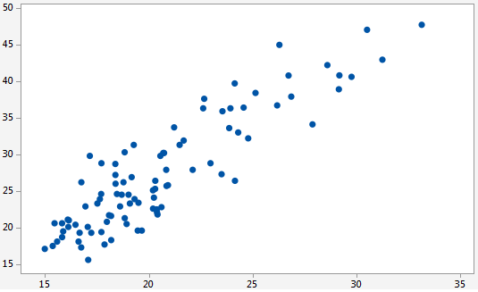
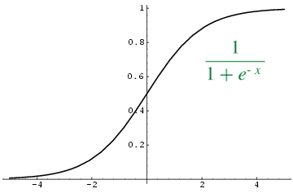
Back to the basics: linear regression
Concepts to remember
We have a (linear) model with 2 parameters:
w – weight (slope)
b – bias (intercept)
Model attempts to minimize the squared-distances between the line and the data points.
Model finds this “best fit” point by repeatedly trying different parameters (w and b) until we’re satisfied.
Model:
y = wx + b
More complex models (also called GLMs):
y = a(w₁x₁ + w₂x₂ + w₃x₃ + … + b)
Multiple explanatory variables and “slope” parameters
An activation function a() transforms the entire output
3

Slide 4
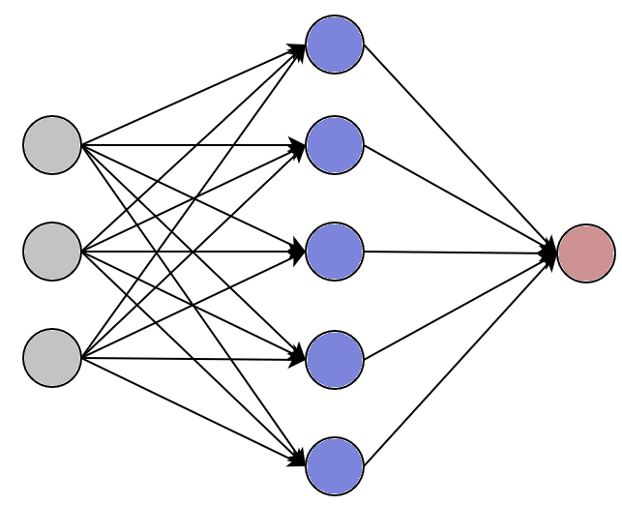
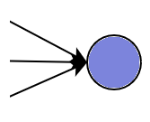
Basics of neural networks
x₁
x₁ (driver’s age)
x₂
x₃
x₂ (vehicle type)
a(w₁x₁ + w₂x₂ + w₃x₃ + b)
-----------------------------------------------------------------
etc…
So:
w₁, w₂, w₃, and b are trainable parameters
Activation a() is usually the sigmoid function
Input Layer
Hidden Layer(s)
Output

Slide 5
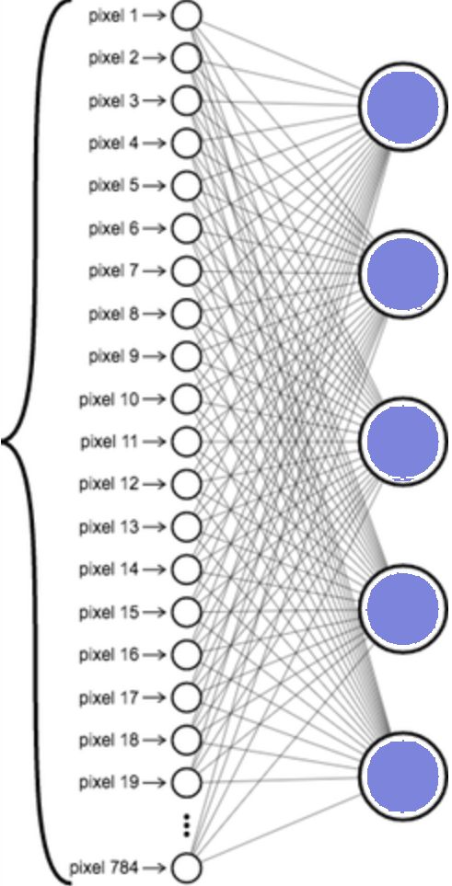
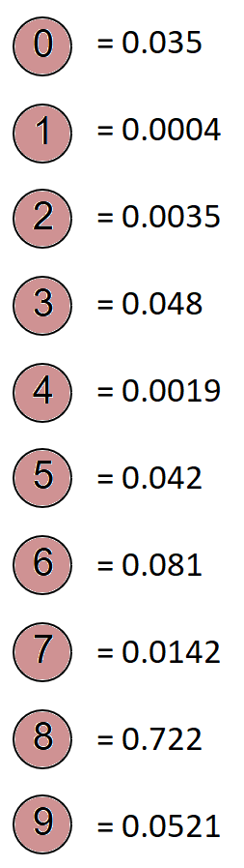
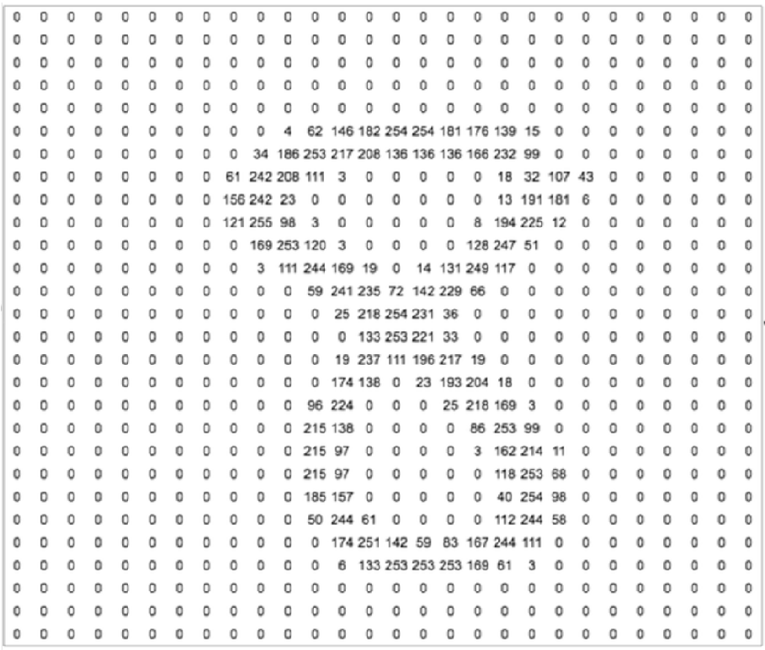
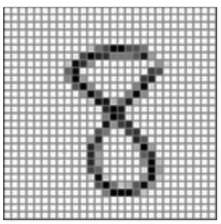
Basics of neural networks – Part 2
Predict: 8
Input Image:
28 x 28 pixels
28 x 28 Matrix
(Grayscale)
Input Layer
(784 neurons)
Hidden
Layer(s)
Output

Slide 6
What we’ve seen so far
0 | 0 | 4 | 0 | 0
0 | 8 | 0 | 9 | 0
0 | 0 | 9 | 0 | 0
0 | 6 | 0 | 4 | 0
0 | 0 | 5 | 0 | 0
More Hidden Layers
Output
Densely connected!
How can we improve this?

Slide 7
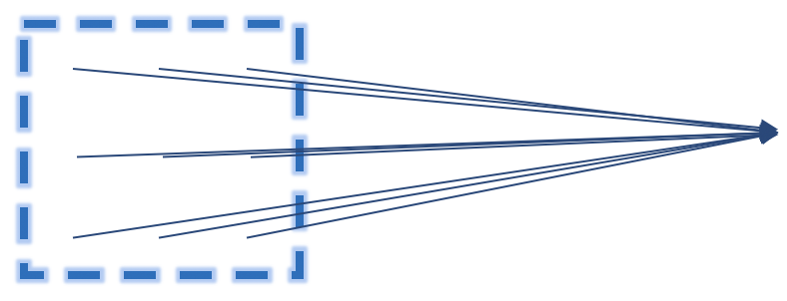
Convolution layers
0 | 0 | 4 | 0 | 0
0 | 8 | 0 | 9 | 0
0 | 0 | 9 | 0 | 0
0 | 6 | 0 | 4 | 0
0 | 0 | 5 | 0 | 0
Filter 1
Filter 2
Input
Filter 3
Etc.
…
Convolution Filter
Locally connected regions (sliding window):
Each neuron in the current layer looks only at a small region from the preceding layer.
Shared weight and bias parameters:
Every neuron in this filter uses the same w and b parameters.
This means that the filter is scanning for the same pattern across different regions from the preceding layer.
Filter 16
Convolution Layer

Slide 8
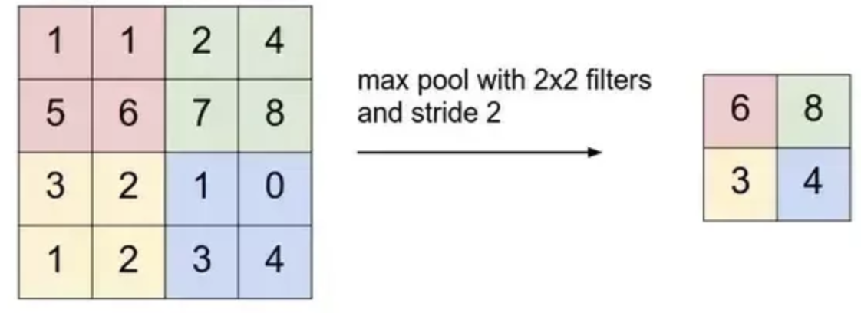
Pooling layers
Filter 1
Filter 2
Input
Filter 3
Pooling Layer
Etc.
Convolution Layer Output
Max-Pool
…
Filter 16
Pooling Layer
Reduces overfitting:
Disregards a some of the information about the exact positions of the patterns detected from the previous layer.
Reduces computation cost:
Output of the pooling layer is much smaller than the input, so future layers have fewer parameters to train.
Convolution Layer

Slide 9
Putting it all together
0 | 0 | 4 | 0 | 0
0 | 8 | 0 | 9 | 0
0 | 0 | 9 | 0 | 0
0 | 6 | 0 | 4 | 0
0 | 0 | 5 | 0 | 0
Pooling Layer
Pooling Layer
Dense Layer
Pooling Layer
Convolution Layer
Convolution Layer
Dense Layer
Convolution Layer
Output
Original Image
Input Matrix
Pattern Detection
Combine
Predict

Slide 10
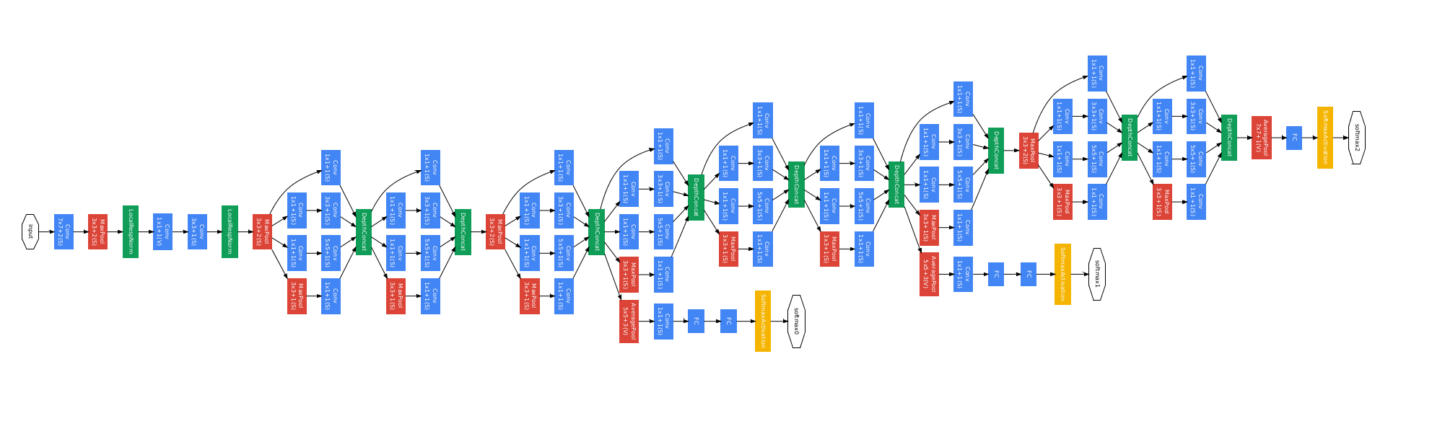
A real-world example (GoogLeNet)
Source: Going Deeper with Convolutions (Szegedy et al. Sept. 2014)

